Slide 1

Chapter 16::
Code Improvement
Programming Language Pragmatics
Michael L. Scott
Copyright © 2009 Elsevier

Slide 2
Introduction
We discussed the generation, assembly, and linking of target code in the back end of a compiler
  We get correct but highly suboptimal code
    redundant computations
    inefficient use of the registers, multiple functional units, and cache
This chapter takes a look at code improvement: the phases of compilation devoted to generating good code
  we interpret “good” to mean fast
  occasionally we also consider program transformations to decrease memory requirements
Copyright © 2009 Elsevier

Slide 3
Introduction
In a very simple compiler, we can use a peephole optimizer to peruse already-generated target code for obviously suboptimal sequences of adjacent instructions
At a slightly higher level, we can generate near-optimal code for basic blocks
  a basic block is a maximal-length sequence of instructions that will always execute in its entirety (assuming it executes at all)
  in the absence of hardware exceptions, control never enters a basic block except at the beginning, and never exits except at the end
Copyright © 2009 Elsevier

Slide 4
Introduction
Code improvement at the level of basic blocks is known as local optimization
  elimination of redundant operations (unnecessary loads, common sub-expression calculations)
  effective instruction scheduling and register allocation
At higher levels of aggressiveness, compilers employ techniques that analyze entire subroutines for further speed improvements
These techniques are known as global optimization
  multi-basic-block versions of redundancy elimination
  instruction scheduling, and register allocation
  code modifications designed to improve the performance of loops
Copyright © 2009 Elsevier

Slide 5
Introduction
Both global redundancy elimination and loop improvement typically employ a control flow graph representation of the program
  Use a family of algorithms known as data flow analysis (flow of information between basic blocks)
Recent compilers perform various forms of interprocedural code improvement
Interprocedural improvement is difficult
  subroutines may be called from many different places
    hard to identify available registers, common subexpressions, etc.
  subroutines are separately compiled
Copyright © 2009 Elsevier

Slide 6
Phases of Code Improvement
We will concentrate in our discussion on the forms of code improvement that tend to achieve the largest increases in execution speed, and are most widely used
  Compiler phases to implement these improvements is shown in Figure 16.1
Copyright © 2009 Elsevier

Slide 7
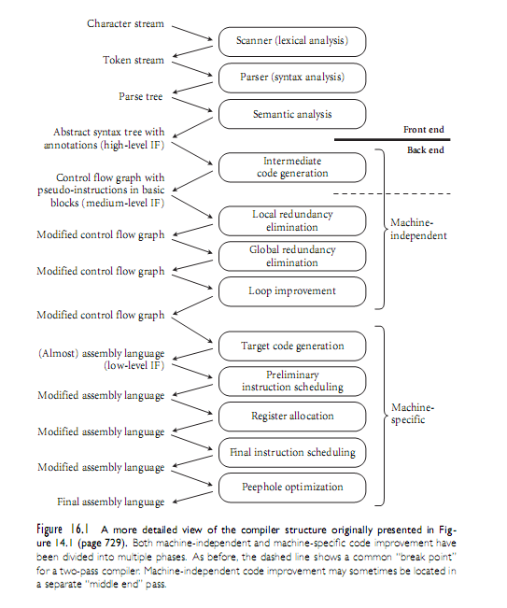
Phases of Code Improvement
Copyright © 2009 Elsevier

Slide 8
Phases of Code Improvement
The machine-independent part of the back end begins with intermediate code generation
  identifies fragments of the syntax tree that correspond to basic blocks
  creates a control flow graph in which each node contains a sequence of three-address instructions for an idealized machine (unlimited supply of virtual registers)
The machine-specific part of the back end begins with target code generation
  strings the basic blocks together into a linear program
    translates each block into the instruction set of the
    target machine and generating branch instructions that
    correspond to the arcs of the control flow graph
Copyright © 2009 Elsevier

Slide 9
Phases of Code Improvement
The machine-independent part of the back end begins with intermediate code generation
  identifies fragments of the syntax tree that correspond to basic blocks
  creates a control flow graph in which each node contains a sequence of three-address instructions for an idealized machine (unlimited supply of virtual registers)
The machine-specific part of the back end begins with target code generation
  strings the basic blocks together into a linear program
    translates each block into the instruction set of the
    target machine and generating branch instructions that
    correspond to the arcs of the control flow graph
Copyright © 2009 Elsevier

Slide 10
Phases of Code Improvement
Machine-independent code improvement has three separate phases
  Local redundancy elimination: identifies and eliminates redundant loads, stores, and computations within each basic block
  Global redundancy elimination: identifies similar redundancies across the boundaries between basic blocks (but within the bounds of a single subroutine)
  Loop improvement: effects several improvements specific to loops
    these are particularly important, since most programs spend most of their time in loops.
    Global redundancy elimination and loop improvement may actually be subdivided into several separate phases
Copyright © 2009 Elsevier

Slide 11
Phases of Code Improvement
Machine-specific code improvement has four separate phases
  Preliminary and final instruction scheduling are essentially identical (Phases 1 & 3)
  Register allocation (Phase 2) and instruction scheduling tend to interfere with one another
    the instruction schedules minimize pipeline stalls which tend to increase the demand for architectural registers (register pressure)
    we schedule instructions first, then allocate architectural registers, then schedule instructions again
      If it turns out that there aren’t enough architectural registers, the register allocator will generate additional load and store instructions to spill registers temporarily to memory
      the second round of instruction scheduling attempts to fill any
      delays induced by the extra loads
Copyright © 2009 Elsevier

Slide 12
Peephole Optimization
A relatively simple way to significantly improve the quality of naive code is to run a peephole optimizer over the target code
  works by sliding a several instruction window (a peephole) over the target code, looking for suboptimal patterns of instructions
  the patterns to look for are heuristic
    patterns to match common suboptimal idioms produced by a particular front end
    patterns to exploit special instructions available on a given machine
A few examples are presented in what follows
Copyright © 2009 Elsevier

Slide 13
Peephole Optimization
Elimination of redundant loads and stores
  The peephole optimizer can often recognize that the value produced by a load instruction is already available in a register
    r2 := r1 + 5
    i := r2
    r3 := i
    r3 := r3 × 3
becomes
    r2 := r1 + 5
    i := r2
    r3 := r2 × 3
Copyright © 2009 Elsevier

Slide 14
Peephole Optimization
Constant folding
A naive code generator may produce code that performs calculations at run time that could actually be performed at compile time
  A peephole optimizer can often recognize such code
r2 := 3 × 2
becomes
r2 := 6
Copyright © 2009 Elsevier

Slide 15
Peephole Optimization
Constant propagation
  Sometimes we can tell that a variable will have a constant value at a particular point in a program
  We can then replace occurrences of the variable with occurrences of the constant
    r2 := 4
    r3 := r1 + r2
    r2 := . . .
    becomes
    r2 := 4
    r3 := r1 + 4
    r2 := . . .
    and then
    r3 := r1 + 4
    r2 := . . .
Copyright © 2009 Elsevier

Slide 16
Peephole Optimization
Common subexpression elimination
  When the same calculation occurs twice within the peephole of the optimizer, we can often eliminate the second calculation:
    r2 := r1 × 5
    r2 := r2 + r3
    r3 := r1 × 5
    becomes
    r4 := r1 × 5
    r2 := r4 + r3
    r3 := r4
  Often, as shown here, an extra register will be needed to hold the common value
Copyright © 2009 Elsevier

Slide 17
Peephole Optimization
It is natural to think of common subexpressions as something that could be eliminated at the source code level, and programmers are sometimes tempted to do so
The following, for example,
      x = a + b + c;
      y = a + b + d;
could be replaced with
      t = a + b;
      x = t + c;
      y = t + d;
Copyright © 2009 Elsevier

Slide 18
Peephole Optimization
Copy propagation
  Even when we cannot tell that the contents of register b will be constant, we may sometimes be able to tell that register b will contain the same value as register
    replace uses of b with uses of a, so long as neither a nor b is modified
    r2 := r1
    r3 := r1 + r2
    r2 := 5
    becomes
    r2 := r1
    r3 := r1 + r1
    r2 := 5
    and then
    r3 := r1 + r1
    r2 := 5
Copyright © 2009 Elsevier

Slide 19
Peephole Optimization
Strength reduction
  Numeric identities can sometimes be used to replace a comparatively expensive instruction with a cheaper one
    In particular, multiplication or division by powers of two can be replaced with adds or shifts:
      r1 := r2 × 2
      becomes
      r1 := r2 + r2 or r1 := r2 << 1
      r1 := r2 / 2
      becomes
      r1 := r2 >> 1
Copyright © 2009 Elsevier

Slide 20
Peephole Optimization
Elimination of useless instructions
  Instructions like the following can be dropped entirely:
    r1 := r1 + 0
    r1 := r1 × 1
Filling of load and branch delays
  Several examples of delay-filling transformations were presented in Chapter 5
Exploitation of the instruction set
  Particularly on CISC machines, sequences of simple instructions can often be replaced by a smaller number of more complex instructions
Copyright © 2009 Elsevier

Slide 21
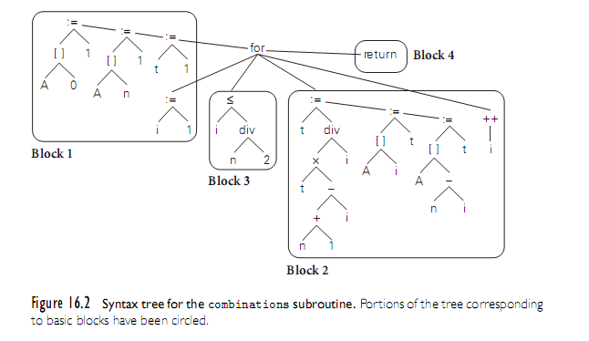
Redundancy Elimination in Basic Blocks
Throughout the remainder of this chapter we will trace the improvement of code for a specific subroutine: calculates into an array the binomial coefficients
Copyright © 2009 Elsevier

Slide 22
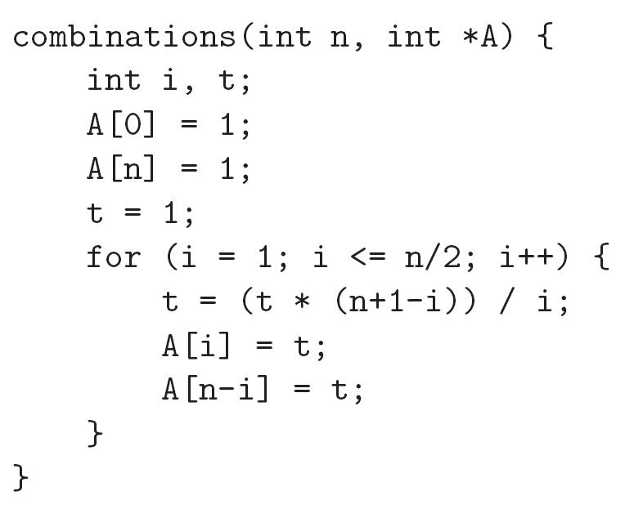
Redundancy Elimination in Basic Blocks
In C, the code looks like this:
Copyright © 2009 Elsevier

Slide 23
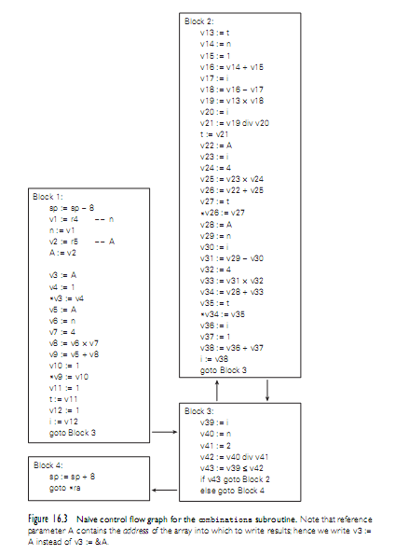
Redundancy Elimination in Basic Blocks
We employ a medium level intermediate form (IF) for control flow
  Every calculated value is placed in a separate register
  To emphasize virtual registers (of which there is an unlimited supply), we name them v1, v2, . . .
  We use r1, r2, . . . to represent architectural registers in Section 16.8.
Copyright © 2009 Elsevier

Slide 24
Redundancy Elimination in Basic Blocks
To improve the code within basic blocks, we need to
  minimize loads and stores
  identify redundant calculations
There are two techniques usually employed
  translate the syntax tree for a basic block into an expression DAG (directed acyclic graph) in which redundant loads and computations are merged into individual nodes with multiple parents
  similar functionality can also be obtained without an explicitly graphical program representation, through a technique known as local value numbering
We describe the last technique below
Copyright © 2009 Elsevier

Slide 25
Redundancy Elimination in Basic Blocks
Value numbering assigns the same name (a “number”) to any two or more symbolically equivalent computations (“values”), so that redundant instances will be recognizable by their common name
Our names are virtual registers, which we merge whenever they are guaranteed to hold a common value
While performing local value numbering, we will also implement
  local constant folding
  constant propagation, copy propagation
  common subexpression elimination
  strength reduction
  useless instruction elimination
Copyright © 2009 Elsevier

Slide 26
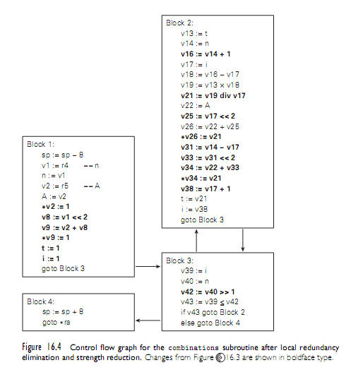
Redundancy Elimination in Basic Blocks
Copyright © 2009 Elsevier

Slide 27
Global Redundancy and
Data Flow Analysis
We now concentrate on the elimination of redundant loads and computations across the boundaries between basic blocks
We translate the code of our basic blocks into static single assignment (SSA) form, which will allow us to perform global value numbering
Once value numbers have been assigned, we shall be able to perform
  global common subexpression elimination
  constant propagation
  copy propagation
Copyright © 2009 Elsevier

Slide 28
Global Redundancy and
Data Flow Analysis
In a compiler both the translation to SSA form and the various global optimizations would be driven by data flow analysis.
  We detail the problems of identifying
    common subexpressions
    useless store instructions
  We will also give data flow equations for the calculation of reaching definitions, used to move invariant computations out of loops
Global redundancy elimination can be structured in such a way that it catches local redundancies as well, eliminating the need for a separate local pass
Copyright © 2009 Elsevier

Slide 29
Global Redundancy and
Data Flow Analysis
Value numbering, as introduced earlier, assigns a distinct virtual register name to every symbolically distinct value that is loaded or computed in a given body of code
  It allows us to recognize when certain loads or computations are redundant.
The first step in global value numbering is to distinguish among the values that may be written to a variable in different basic blocks
  We accomplish this step using static single assignment (SSA) form
Copyright © 2009 Elsevier

Slide 30
Global Redundancy and
Data Flow Analysis
For example, if the instruction v2 := x is guaranteed to read the value of x written by the instruction x3 := v1, then we replace v2 := x with v2 := x3
If we cannot tell which version of x will be read, we use a hypothetical function φ to choose among the possible alternatives
  we won’t actually have to compute φ-functions at run time
    the only purpose is to help us identify possible code improvements
  we will drop them (and the subscripts) prior to target code generation
Copyright © 2009 Elsevier

Slide 31
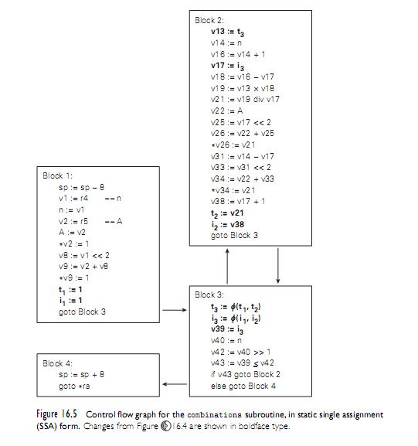
Global Redundancy and
Data Flow Analysis
Copyright © 2009 Elsevier

Slide 32
Global Redundancy and
Data Flow Analysis
With flow-dependent values determined by φ-functions, we are now in a position to perform global value numbering
  As in local value numbering, the goal is to merge any virtual registers that are guaranteed to hold symbolically equivalent expressions
  In the local case, we were able to perform a linear pass over the code
  We kept a dictionary that mapped loaded and computed expressions to the names of virtual registers that contained them
Copyright © 2009 Elsevier

Slide 33
Global Redundancy and
Data Flow Analysis
This approach does not suffice in the global case, because the code may have cycles
  The general solution can be formulated using data flow
  It can also be obtained with a simpler algorithm that begins by unifying all expressions with the same top-level operator
    In the end, repeatedly separates expressions whose operands are distinct
    It is quite similar to the DFA minimization algorithm of Chapter 2
We perform this analysis for our running example informally
Copyright © 2009 Elsevier

Slide 34
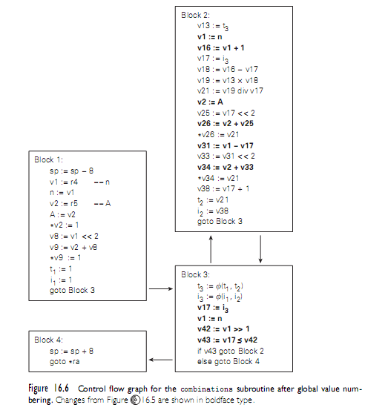
Global Redundancy and
Data Flow Analysis
Copyright © 2009 Elsevier

Slide 35
Global Redundancy and
Data Flow Analysis
Many instances of data flow analysis can be cast in the following framework:
  four sets for each basic block B, called In_{B}, Out_{B}, Gen_{B}, and Kill_{B};
  values for the Gen and Kill sets;
  an equation relating the sets for any given block B;
  an equation relating the Out set of a given block to the In sets of its successors, or relating the In set of the block to the Out sets of its predecessors; and (often)
  certain initial conditions
Copyright © 2009 Elsevier

Slide 36
Global Redundancy and
Data Flow Analysis
The goal of the analysis is to find a fixed point of the equations: a consistent set of In and Out sets (usually the smallest or the largest) that satisfy both the equations and the initial conditions
  Some problems have a single fixed point
  Others may have more than one
    we usually want either the least or the greatest fixed point (smallest or largest sets)
Copyright © 2009 Elsevier

Slide 37
Global Redundancy and
Data Flow Analysis
In the case of global common subexpression elimination, In_{B} is the set of expressions (virtual registers) guaranteed to be available at the beginning of block B
  These available expressions will all have been set by predecessor blocks
  Out_{B} is the set of expressions guaranteed to be available at the end of B
  Kill_{B} is the set of expressions killed in B: invalidated by assignment to one of the variables used to calculate the expression, and not subsequently recalculated in B
  Gen_{B} is the set of expressions calculated in B and not subsequently killed in B
Copyright © 2009 Elsevier

Slide 38
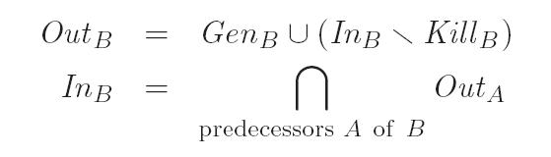
Global Redundancy and
Data Flow Analysis
The data flow equations for available expression analysis are:
Our initial condition is In₁ = ∅: no expressions are available at the beginning of execution
Copyright © 2009 Elsevier

Slide 39
Global Redundancy and
Data Flow Analysis
Available expression analysis is known as a forward data flow problem, because information flows forward across branches: the In set of a block depends on the Out sets of its predecessors
  We will see an example of a backward data flow problem later
We calculate the desired fixed point of our equations in an inductive (iterative) fashion, much as we computed first and follow sets in Chapter 2
Our equation for In_{B} uses intersection to insist that an expression be available on all paths into B
  In our iterative algorithm, this means that In_{B} can only shrink with subsequent iterations
Copyright © 2009 Elsevier

Slide 40
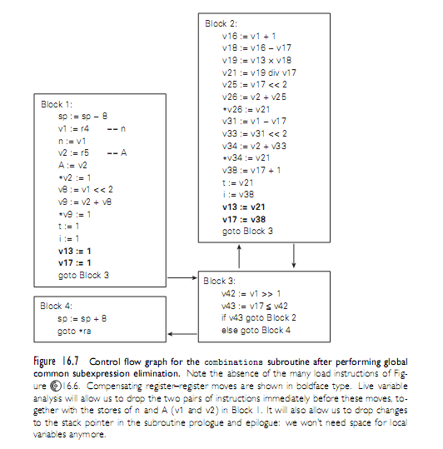
Global Redundancy and
Data Flow Analysis
Copyright © 2009 Elsevier

Slide 41
Global Redundancy and
Data Flow Analysis
We turn our attention to live variable analysis -very important in any subroutine in which global common subexpression analysis has eliminated load instructions
Live variable analysis is a backward flow problem
It determines which instructions produce values that will be needed in the future, allowing us to eliminate dead (useless) instructions
  in our example we consider only values written to memory and with the elimination of dead stores
  applied to values in virtual registers as well, live variable analysis can help to identify other dead instructions
Copyright © 2009 Elsevier

Slide 42
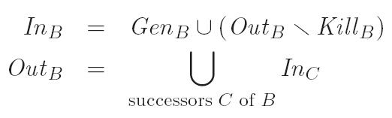
Global Redundancy and
Data Flow Analysis
For this instance of data flow analysis
  In_{B} is the set of variables live at the beginning of block B
  Out_{B} is the set of variables live at the end of the block
  Gen_{B} is the set of variables read in B without first being written in B
  Kill_{B} is the set of variables written in B without having been read first
The data flow equations are:
Copyright © 2009 Elsevier

Slide 43
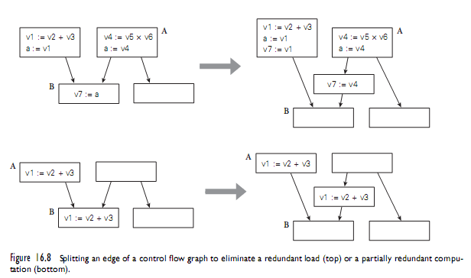
Global Redundancy and
Data Flow Analysis
Copyright © 2009 Elsevier

Slide 44
Loop Improvement I
We consider two classes of loop improvements:
  those that move invariant computations out of the body of a loop and into its header, and
  those that reduce the amount of time spent maintaining induction variables
Later we consider transformations that improve instruction scheduling by restructuring a loop body to include portions of more than one iteration of the original loop
  manipulate multiply nested loops to improve cache performance or increase opportunities for parallelization
Copyright © 2009 Elsevier

Slide 45
Loop Improvement I
A loop invariant is an instruction (i.e., a load or calculation) in a loop whose result is guaranteed to be the same in every iteration
  If a loop is executed n times and we are able to move an invariant instruction out of the body and into the header (saving its result in a register for use within the body), then we will eliminate n -1 calculations from the program
    a potentially significant savings
In order to tell whether an instruction is invariant, we need to identify the bodies of loops, and we need to track the locations at which operand values are defined
Copyright © 2009 Elsevier

Slide 46
Loop Improvement I
Tracking the locations at which an operand may have been defined amounts to the problem of reaching definitions
  Formally, we say an instruction that assigns a value v into a location (variable or register) l reaches a point p in the code if v may still be in l at p
Like the conversion to static single assignment form, considered informally earlier, the problem of reaching definitions can be structured as a set of forward, any-path data flow equations
  We let Gen_{B} be the set of final assignments in block B (those that are not overwritten later in B)
  For each assignment in B we also place in Kill_{B} all other assignments (in any block) to the same location
Copyright © 2009 Elsevier

Slide 47
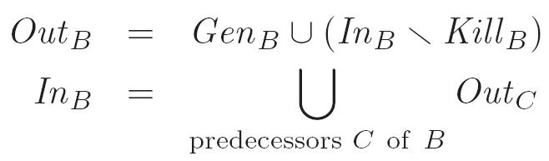
Loop Improvement I
Then we have
Given In_{B} (the set of reaching definitions at the beginning of the block), we can determine the reaching definitions of all values used within B by a simple linear perusal of the code
Copyright © 2009 Elsevier

Slide 48
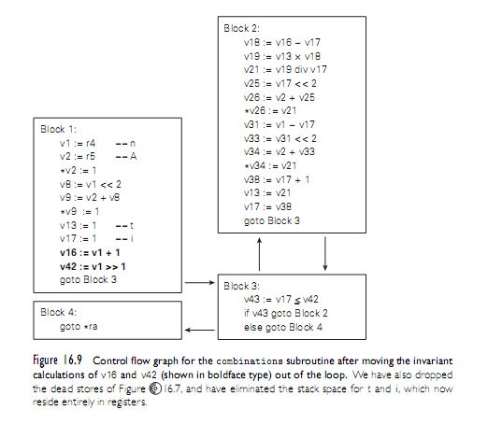
Loop Improvement I
Copyright © 2009 Elsevier

Slide 49
Loop Improvement I
An induction variable (or register) is one that takes on a simple progression of values in successive iterations of a loop.
  We confine our attention to arithmetic progressions
  Induction variables appear as loop indices, subscript computations, or variables incremented or decremented explicitly within the body of the loop
Induction variables are important for two reasons:
  They commonly provide opportunities for strength reduction, replacing multiplication with addition
  They are commonly redundant: instead of keeping several induction variables in registers, we can often keep a smaller number and calculate the remainder
  from those when needed
Copyright © 2009 Elsevier

Slide 50
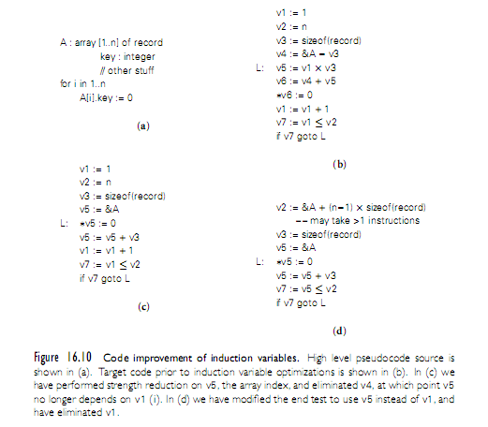
Loop Improvement I
Copyright © 2009 Elsevier

Slide 51
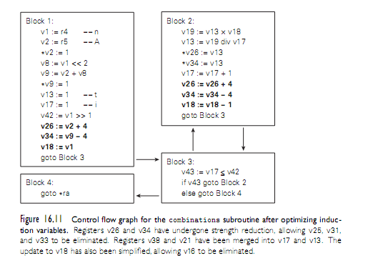
Loop Improvement I
Copyright © 2009 Elsevier

Slide 52
Instruction Scheduling
We will perform two rounds of instruction scheduling separated by register allocation
  Given our use of pseudoassembler, we won’t consider peephole optimization in any further detail
  On a pipelined machine, performance depends critically on the extent to which the compiler is able to keep the pipeline full
    A compiler can solve the subproblem of filling branch delays in a more or less straightforward fashion
  If we examine the body of the loop in our combinations example, optimizations described thus far have transformed Block 2 from the 30 instruction sequence into the eight instruction sequence of Figure 16.11
    Unfortunately, on a pipelined machine without instruction reordering, this code is still distinctly suboptimal
Copyright © 2009 Elsevier

Slide 53
Instruction Scheduling
To schedule instructions to make better use of the pipeline, we first arrange them into a directed acyclic graph (DAG), in which each node represents an instruction, and each arc represents a dependence
  Most arcs will represent flow dependences, in which one instruction uses a value produced by a previous instruction
  A few will represent anti-dependences, in which a later instruction overwrites a value read by a previous instruction
  In our example, these will correspond to updates of induction variables
Copyright © 2009 Elsevier

Slide 54
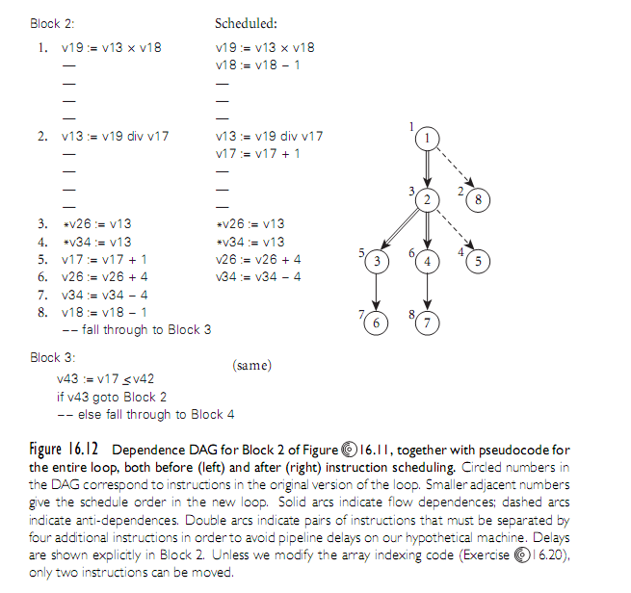
Instruction Scheduling
Copyright © 2009 Elsevier

Slide 55
Loop Improvement II
Loop Unrolling and Software Pipelining
Loop unrolling is a transformation that embeds two or more iterations of a source-level loop in a single iteration of a new, longer loop, and allowing the scheduler to intermingle the instructions of the original iterations
If we unroll two iterations of our combinations example we obtain the code of Figure 16.13
  We have used separate names (here starting with the letter ‘t’) for registers written in the initial half of the loop
  This convention minimizes anti- and output dependences, giving us more latitude in scheduling
Copyright © 2009 Elsevier

Slide 56
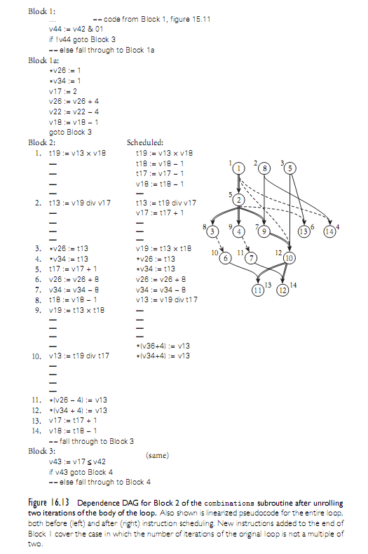
Loop Improvement II
Copyright © 2009 Elsevier

Slide 57
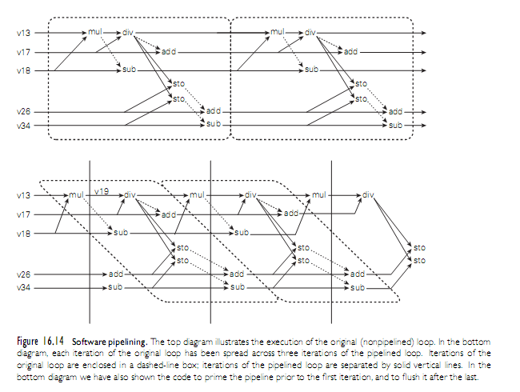
Loop Improvement II
Copyright © 2009 Elsevier

Slide 58
Loop Improvement II
A software-pipelined version of our combinations subroutine appears in the bottom half of Figure 16.14 and as a control flow graph in Figure 16.15
  The idea is to build a loop whose body comprises portions of several consecutive iterations of the original loop, with no internal start-up or shut-down cost
  In our example, each iteration of the software-pipelined loop contributes to three separate iterations of the original loop
  Within each new iteration (shown between vertical bars) nothing needs to wait for the divide to complete
  To avoid delays, we have altered the code in several ways
Copyright © 2009 Elsevier

Slide 59
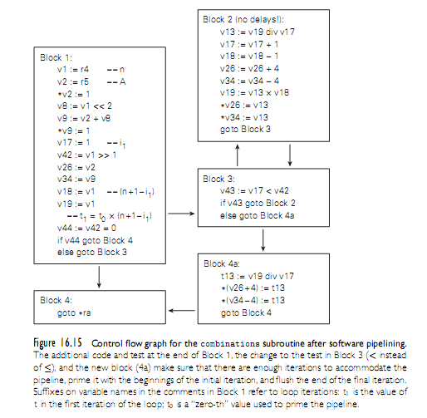
Loop Improvement II
Copyright © 2009 Elsevier

Slide 60
Loop Improvement II
Loop Reordering
The code improvement techniques that we have considered thus far have served two principal purposes
  eliminate redundant or unnecessary instructions
  minimize stalls on a pipelined machine.
Two other goals have become increasingly important in recent years
  it has become increasingly important to minimize cache misses (processor speed outstrips memory latency)
  it has become important to identify sections of code that can execute concurrently (parallel machines)
As with other optimizations, the largest benefits come from changing the behavior of loops
Copyright © 2009 Elsevier

Slide 61
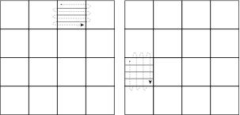
Loop Improvement II
Loop Reordering
A loop-reordering compiler can improve this code by interchanging the nested loops:
    for j := 1 to n
    for i := 1 to n
    A[i, j] := 0
Copyright © 2009 Elsevier
Figure 16.16 Tiling (blocking) of a matrix operation

Slide 62
Loop Improvement II
Loop Reordering
    for i := 1 to n
    for j := 1 to n
    A[i, j] := 0
If A is laid out in row-major order, and if each cache line contains m elements of A, then this code will suffer n²/m cache misses
If A is laid out in column major order, and if the cache is too small to hold n lines of A, then the code will suffer n² misses, fetching the entire array
from memory m times
Copyright © 2009 Elsevier

Slide 63
Loop Improvement II
Loop Dependences
When reordering loops, we must to respect all data dependences (loop-carried dependences)
    i := 2 to n
    for j := 1 to n1
    A[i, j] := A[i, j] A[i1, j+1]
Here the calculation of A[i, j] in iteration (i, j) depends on the value of A[i-1, j+1], which was calculated in iteration (i-1, j+1).
This dependence is often represented by a diagram of the iteration space (see next slide):
Copyright © 2009 Elsevier

Slide 64
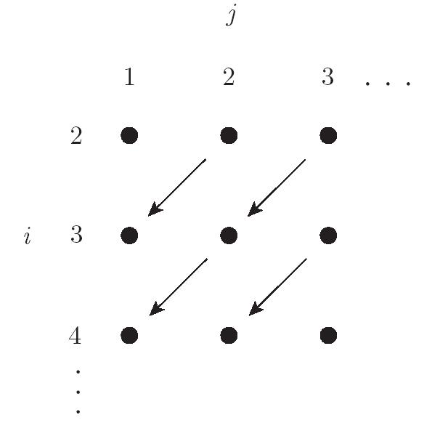
Loop Improvement II
The i and j dimensions in this diagram represent loop indices, not array subscripts.
  The arcs represent the loop-carried flow dependence
If we wish to interchange the i and j loops of this code (e.g., to improve cache locality), we find that we cannot do it, because of the dependence: we would end up trying to write A[i, j] before we had written A[i-1, j+1]
Copyright © 2009 Elsevier

Slide 65
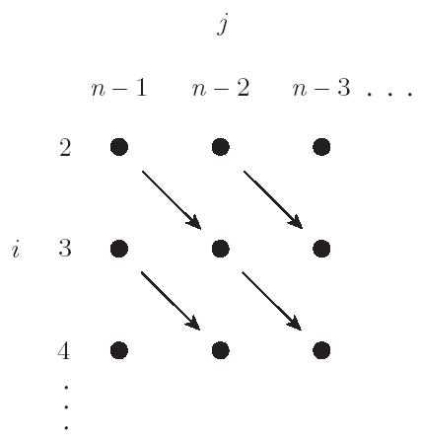
Loop Improvement II
By analyzing the loop dependence, we note that we can reverse the order of the j loop without violating the dependence:
for i := 2 to n
for j := n1 to 1 by 1
A[i, j] := A[i, j] A[i1, j+1]
This change transforms the iteration space as shown here
Copyright © 2009 Elsevier

Slide 66
Loop Improvement II
Another transformation that sometimes serves to eliminate a dependence is known as loop skewing
  it reshapes a rectangular iteration space into a parallelogram, by adding the outer loop index to the inner one, and then subtracting from the appropriate subscripts:
  for i := 2 to n
  for j := i+1 to i+n-1
  A[i,j-i]:= A[i,j-i]-A[i1,j+1-i]
A moment’s consideration will reveal that this code accesses the exact same elements as before, in the exact same order
Copyright © 2009 Elsevier

Slide 67
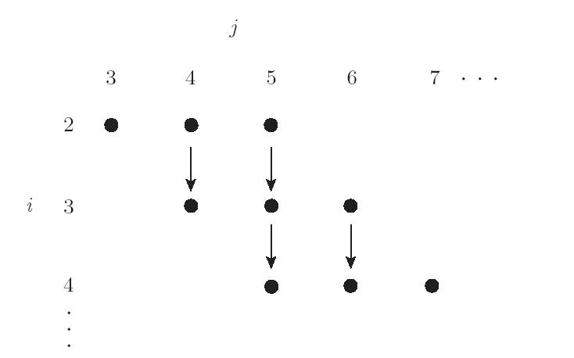
Loop Improvement II
Its iteration space, however, looks like here (the loops can be safely be interchanged)
Copyright © 2009 Elsevier

Slide 68
Loop Improvement II
Parallelization
Loop iterations (at least in non-recursive programs) constitute the principal source of operations that can execute in parallel
  one needs to find independent loop iterations - with no loop-carried dependences
Even in languages without special constructs, a compiler can often parallelize code by identifying—or creating—loops with as few loop-carried dependences as possible
  These transformations are valuable tools in this endeavor
Copyright © 2009 Elsevier

Slide 69
Loop Improvement II
Consider the problem of “zero-ing out” a two-dimensional array (row-major order):
  for i := 0 to n-1
  for j := 0 to n-1
  A[i, j] := 0
On a machine containing several general purpose processors, we parallelize the outer loop:
–– on processor pid:
for i := (n/p × pid) to (n/p ×(pid + 1)-1)
  for j := 1 to n
  A[i, j] := 0
Copyright © 2009 Elsevier

Slide 70
Loop Improvement II
Other issues of importance in parallelizing compilers include communication and load balance
Locality in parallel programs reduces communication among processors and between the processors and memory
  Optimizations similar to those employed to reduce the number of cache misses on a uniprocessor can be used to reduce communication trafic on a multiprocessor.
Load balance refers to the division of labor among processors on a parallel machine
  dividing a program among 16 processors, we shall obtain a speedup of close to 16 only if each processor takes the same amount of time to do its work
  assigning 5% of the work to each of 15 processors and 25% of the work to the sixteenth, we are likely to see a speedup of no more than four
Copyright © 2009 Elsevier

Slide 71
Register Allocation
In a simple compiler with no global optimizations, register allocation can be performed independently in every basic block
  simple compilers usually apply a set of heuristics to identify such frequently accessed variables variables and allocate them to registers over the life of a subroutine.
  candidates for a dedicated register include loop indices, the implicit pointers of with statements in Pascal-family languages, and scalar local variables and parameters
It has been known since the early 1970s that register allocation is equivalent to the NP-hard problem of graph coloring
Copyright © 2009 Elsevier

Slide 72
Register Allocation
We first identify virtual registers that cannot share an architectural register, because they contain values that are live concurrently
  we use reaching definitions data flow analysis
  we then determine the live range of variables
Given these live ranges, we construct a register interference graph
  The nodes of this graph represent virtual registers. Registers vi and vj are connected by an arc if they are simultaneously live
  The interference graph corresponding to Figure 15.17 appears in Figure 15.18 (see next slides)
Copyright © 2009 Elsevier

Slide 73
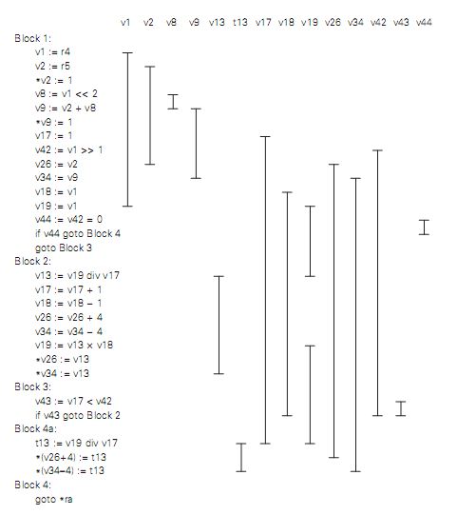
Register Allocation
For the software-pipelined version of our earlier combinations subroutine (Figure 16.15), we chart the live ranges of the virtual registers as shown in Figure 16.17
  Note that the live range of v19 spans the backward branch at the end of Block 2; though typographically disconnected it is contiguous in time
Copyright © 2009 Elsevier

Slide 74
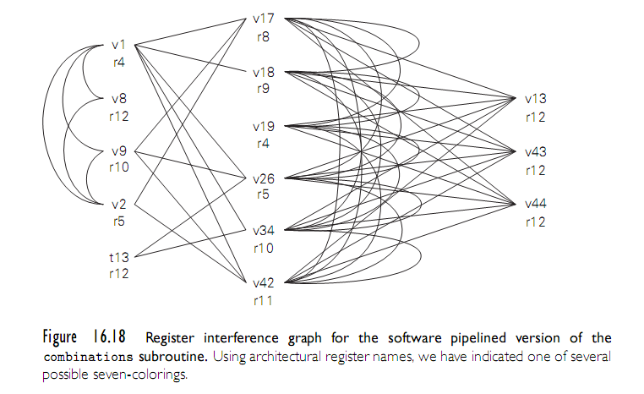
Register Allocation
Copyright © 2009 Elsevier

Slide 75
Register Allocation
The problem of mapping virtual registers onto the smallest possible number of architectural registers now amounts to finding a minimal coloring of this graph - an assignment of “colors” to nodes such that no arc connects two nodes of the same color
In our example, we can find one of several optimal solutions by inspection
  note that the six registers in the center of the figure constitute a clique (a completely connected subgraph); each must be mapped to a separate architectural register
  final code for the combinations subroutine appears in Figure 16.19
Copyright © 2009 Elsevier

Slide 76
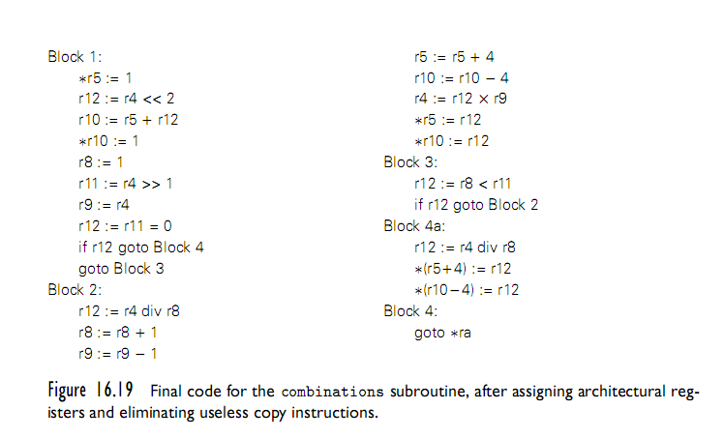
Register Allocation
Copyright © 2009 Elsevier

